Slide 1

ELECTION RESULT PREDICTION
USING SENTIMENT ANALYSIS OF TWEETS

Slide 2
Project Idea
The ability to share thoughts through social media has grown significantly. To share thoughts, reviews, and ratings, social media sites like Facebook and Twitter are available. Millions of people follow the official Twitter accounts of all major political parties and their representatives worldwide. They see this platform as a way to interact with young people who might support them in elections. Due to the enormous increase in Twitter users during the pandemic, people have been more outspoken in their support or criticism of political decisions.

Slide 3
In a democratic nation, elections are crucial. The Indian parliamentary system allows its citizens the power to choose who will serve as their leaders for the upcoming four years.
The general public as well as political parties can utilize sentiment analysis of tweets relating to elections to understand the positive or negative sentiments of individuals regarding a particular political party, helping to anticipate the election results at that time.
We have designed our project in such a manner that it will predict the result of an election by using the tweets of the citizens. It will basically analyze the sentiment of tweets and classify tweets in three categories positive, negative and neutral with respect to election candidates. Based on the percentage of positive and negative tweets, the election winner will be predicted.

Slide 4
Methodology
1. Importing the Libraries.
2. Loading the Training Dataset.
3. Normalizing the Dataset
4. Reshape the data
5. Building the Model by Importing the Libraries.
7. Extracting the Actual Tweets.
8. Predicting the future Values.
9. Predicted Result.

Slide 5
Data Collection
The first stage of the research is the data gathering process, during which information is gathered from twitter. There are two ways to connect to Twitter and gather tweets from it. The first technique involves looking up tweets using the relevant keywords. The second way involves gathering all of the tweets that Twitter provides through its streaming API, or all of the tweets in a particular language, or all of the tweets from a particular region, and then putting them all into a database.

Slide 6
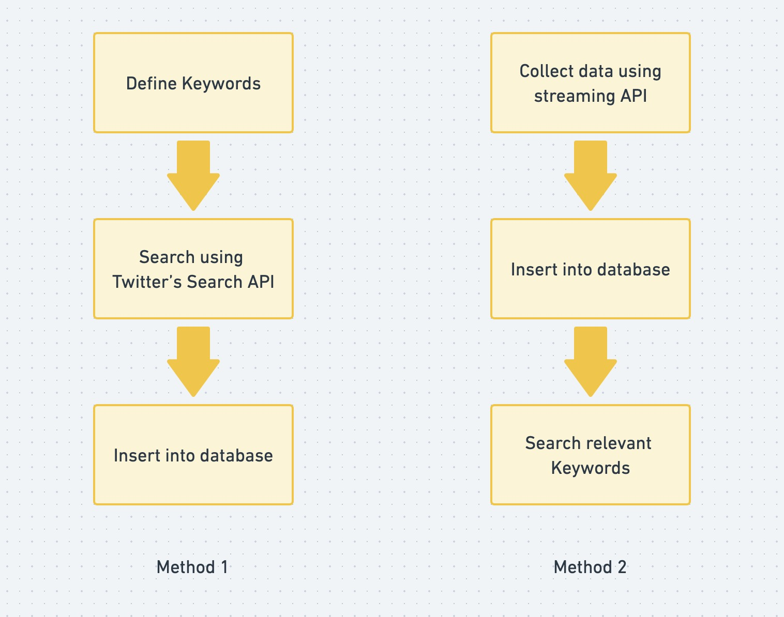

Slide 7
Sentiment Analysis
Sentiment analysis, often known as opinion mining, is a technique used in natural language processing (NLP) to determine the emotional undertone of a document. This is a common method used by organizations to identify and group ideas regarding a certain good, service, or concept.
Sentiment analysis is primarily concerned with a text's polarity (positive, negative, or neutral), but it also extends beyond polarity to identify certain moods and emotions (angry, joyful, sad, etc.), urgency (urgent, not urgent), and even intents (interested v. not interested).
Sentiment analysis is quickly becoming into a crucial tool to monitor and comprehend sentiment in all forms of data because people express their views and feelings more freely than ever before.

Slide 8
Our Approach
In our research, we used Lexicon Based Approach of Semantic Analysis.
In this approach, a sentiment is defined by its semantic orientation and the intensity of each word in the sentence. This requires a pre-defined dictionary classifying negative and positive words. Generally, a text message will be represented by bag of words. After assigning individual scores to all the words, final sentiment is calculated by some pooling operation like taking an average of all the sentiments.

Slide 9
There are three main approaches to compile sentiment words.
Three main approaches are: manual approach, dictionary-based approach, and corpus-
based approach. In our research we used dictionary-based approach.
We used eleven different variables for classification, that variables are sadness, tentativeness, anxiety, work, anger, certainty, achievement, positive words, negative words, positive hashtag and negative hashtag.

Slide 10
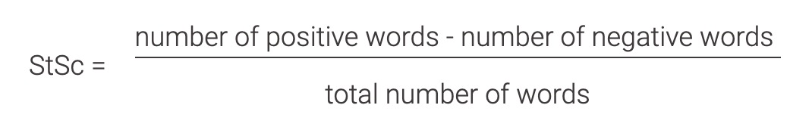
Once each word in the text is labeled, we can derive an overall sentiment score by counting the numbers of positive and negative words and combining these values mathematically. A popular formula to calculate the sentiment score (StSc) is:
If the sentiment score is negative, the text is classified as negative. It follows that a positive score means a positive text, and a score of zero means the text is classified as neutral.
The overall sentiment of the text is determined on-the-fly, depending only on the dictionary that is used for labeling words.

Slide 11
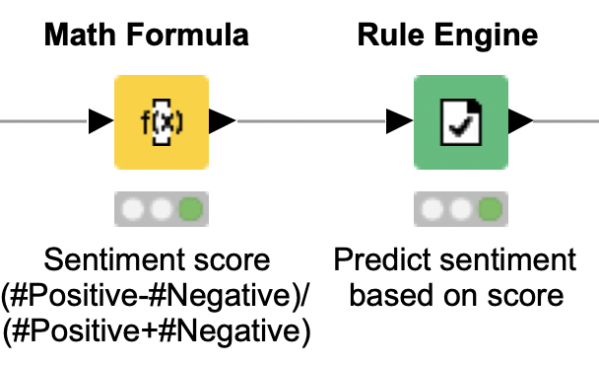

Slide 12
Tools
Tweepy
Tweepy is an open source Python package that gives you a very convenient way to access the Twitter API with Python.
2. Textblob
TextBlob is a Python (2 and 3) library for processing textual data. It provides a simple API for diving into common natural language processing (NLP) tasks such as part-of-speech tagging, noun phrase extraction, sentiment analysis, classification, translation, and more.

Slide 13
3. Pandas
Data Manipulation and analysis library
4. Numpy
Scientific computing library
5. Matplotlib
Plotting library in python
6. Plotly
Another plotting library in python
7. Seaborn
Data visualization library based on matplotlib
8. Wordcloud
Library for visual representation of textual data

Slide 14
Sentiment Analysis using Textblob
TextBlob is a python library for Natural Language Processing (NLP). TextBlob actively used Natural Language Tool Kit (NLTK) to achieve its tasks. NLTK is a library which gives an easy access to a lot of lexical resources and allows users to work with categorization, classification and many other tasks. TextBlob is a simple library which supports complex analysis and operations on textual data.
TextBlob returns polarity and subjectivity of a sentence. Polarity lies between [-1,1], -1 defines a negative sentiment and 1 defines a positive sentiment.
Subjectivity lies between [0,1]. Subjectivity quantifies the amount of personal opinion and factual information contained in the text. The higher subjectivity means that the text contains personal opinion rather than factual information.

Slide 15
For example: We calculated polarity and subjectivity for “I do not like this example at all, it is too boring”. For this particular example, polarity = -1 and subjectivity is 1, which is fair.
It is expected that if the library returns exactly 0.0 it means your sentence didn’t contain any words that had a polarity in the NLTK training set.

Slide 16

Results
We collect data through twitter API, after that we performed preprocessing on that data.
For collected data for US election we classified polarity. Classifying tweets in three categories positive, negative and neutral.

Slide 17
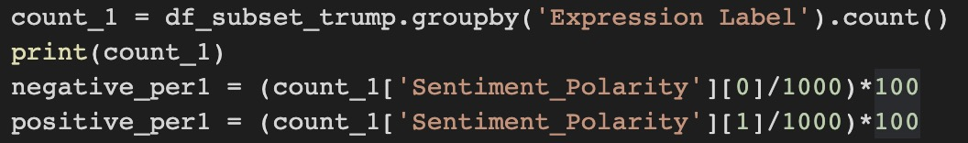
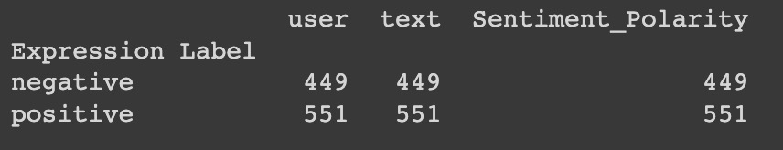
Comparing percentage counts
For Donald Trump

Slide 18
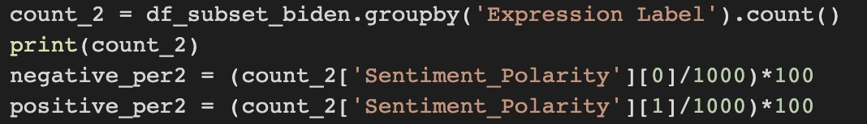
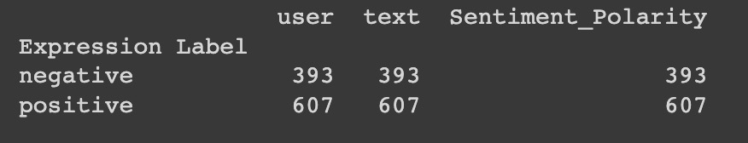
Comparing percentage counts
For Joe Biden

Slide 19
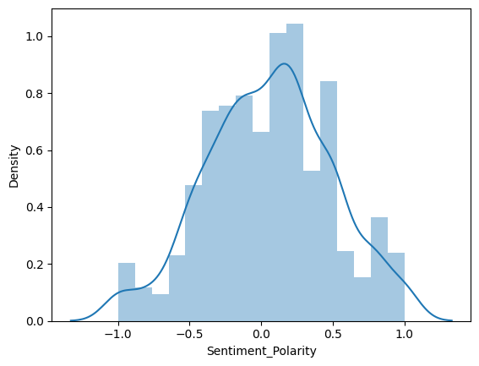
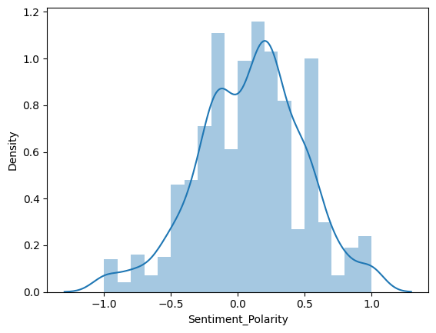
Sentiment Polarity Visualization
For Trump For Biden

Slide 20
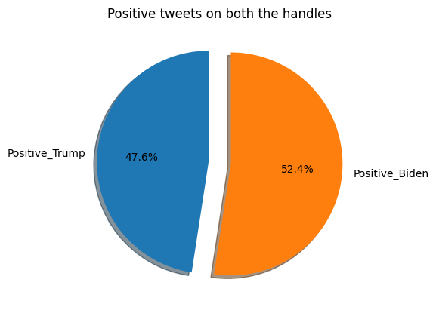
Positive tweets comparison
of both candidates

Slide 21
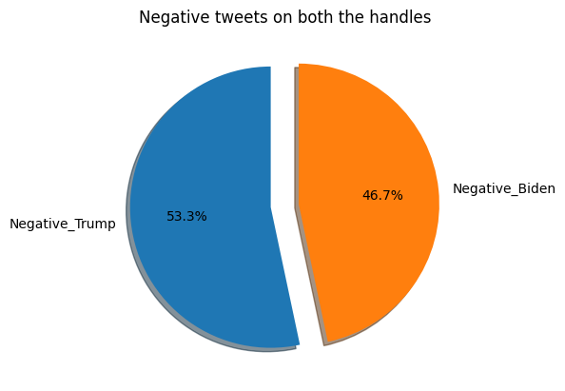
Negative tweets comparison
of both candidates

Slide 22
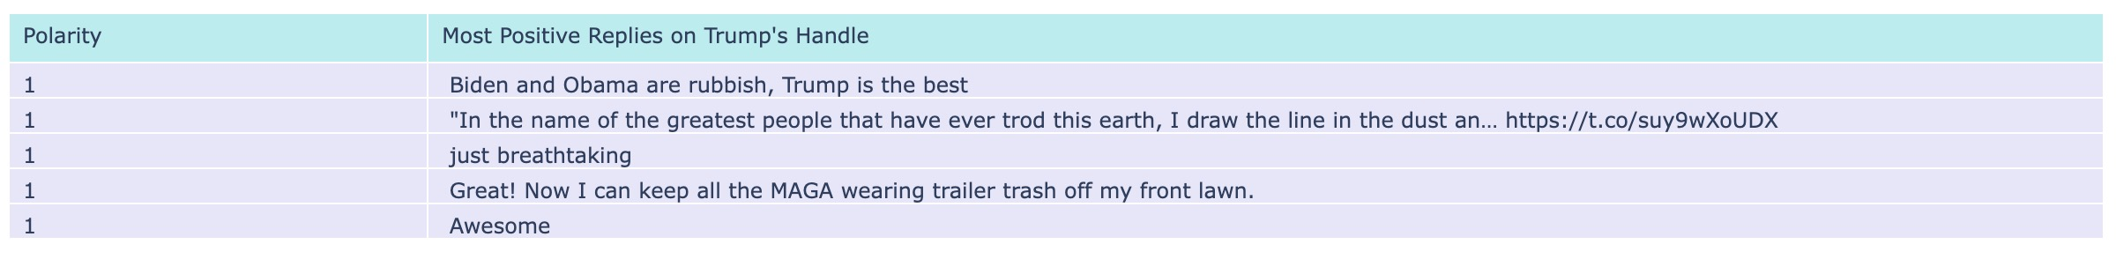
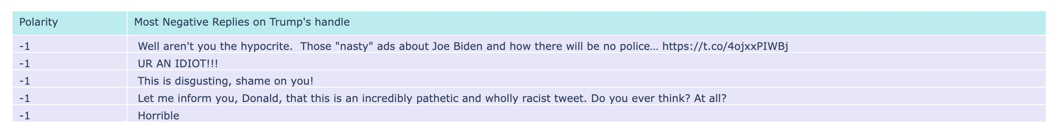
Visualizing Most Positive and Negative tweets for Donald Trump

Slide 23
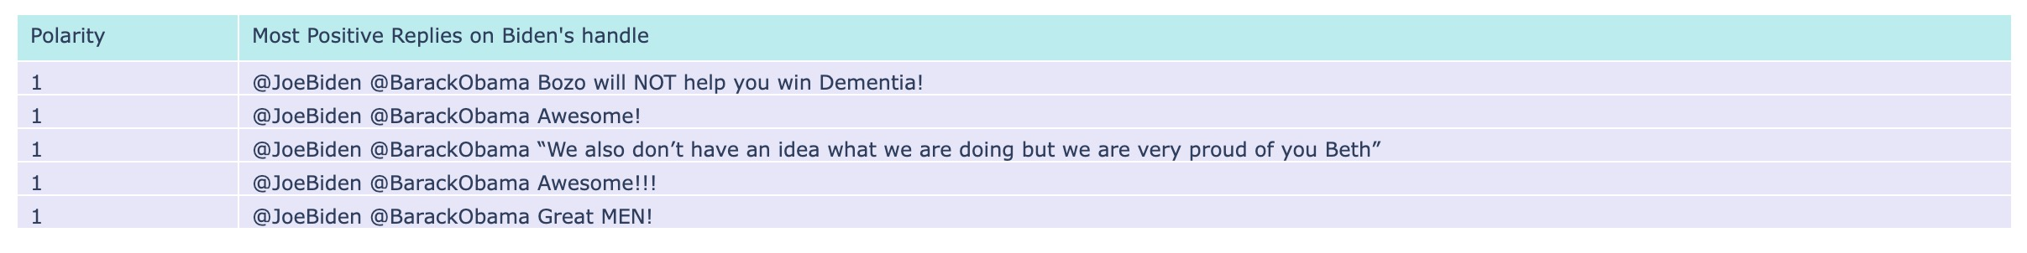
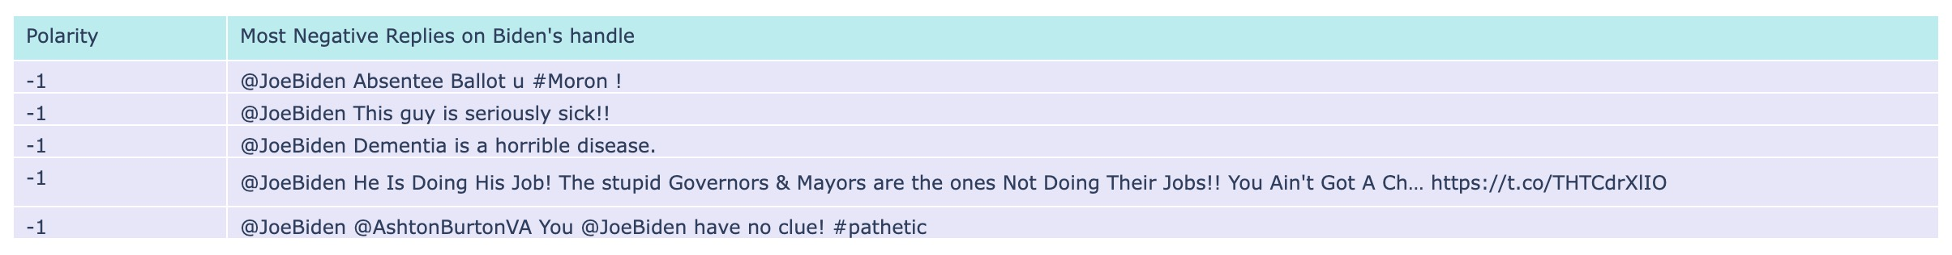
Visualizing Most Positive and Negative tweets for Joe Biden

Slide 24
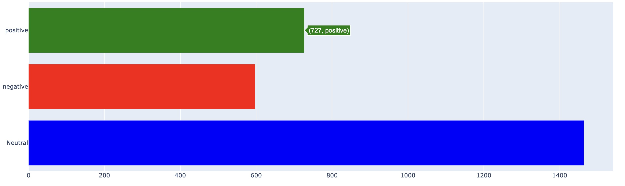
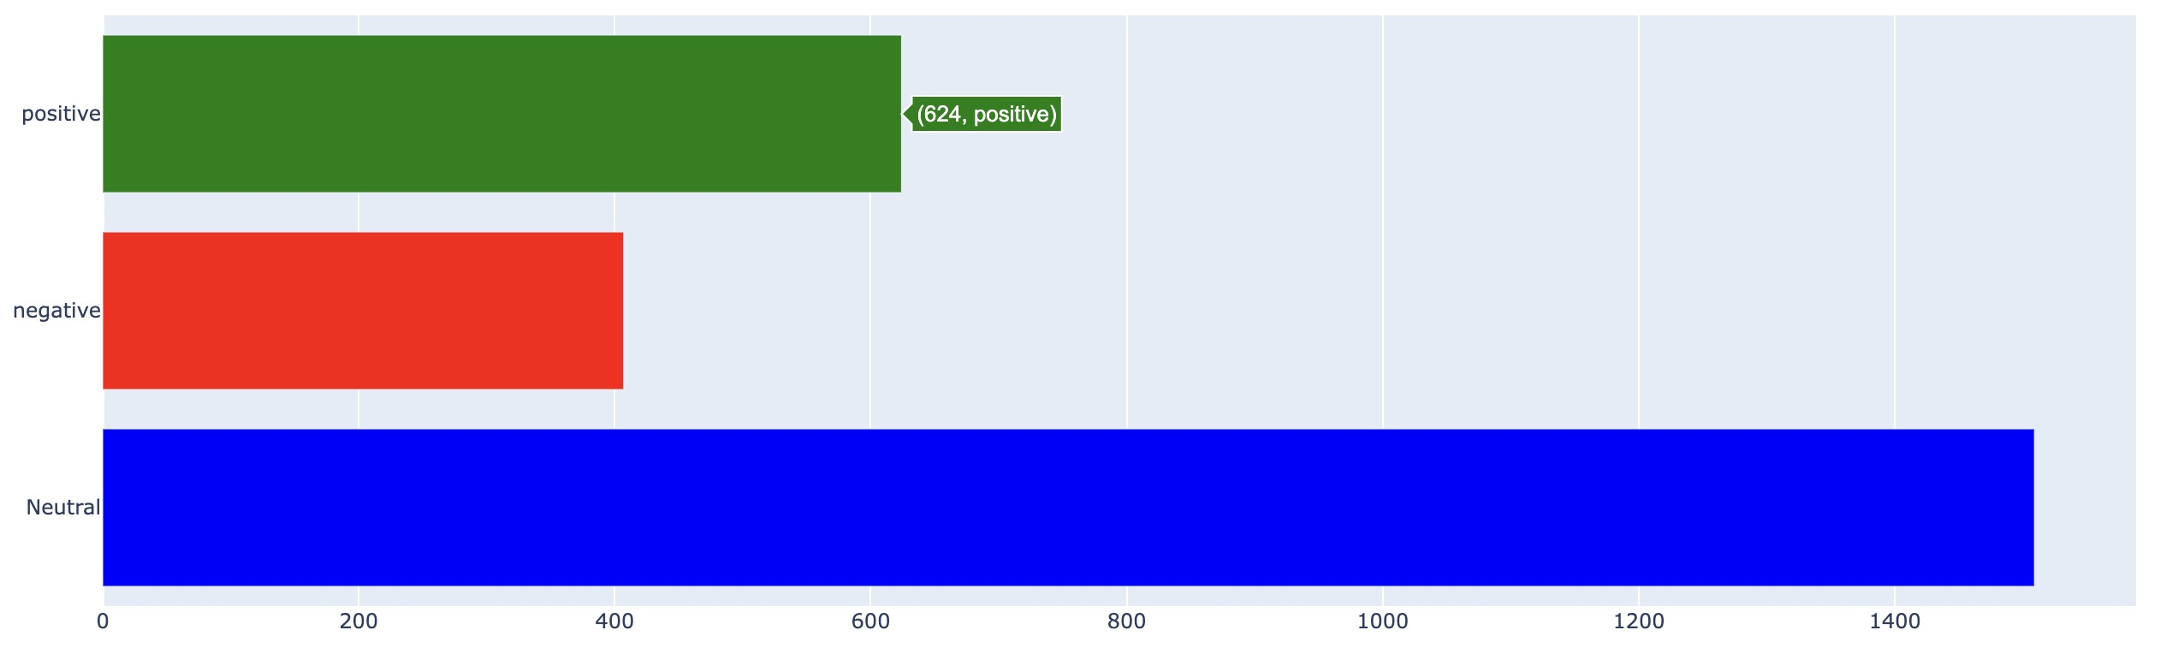
Trump's Tweets Analysis
Biden's Tweets Analysis
We can observe that in sentiment analysis positive tweets were more in Biden data than that of trump and vice versa. Neutral tweets are also more for Biden.
As prediction we can predict that Joe Biden will win elections from tweeter data we collected.

Slide 25
Predicting election results for our Lok Sabha
Here, we first followed the same approach for calculating the sentiment score for all three parties; BJP, NCP and AAP using TextBlob.
But now, we will also use different Machine Learning models for classification and compare them on the basis of precision, recall, accuracy and F-measure.
Now, Let's dicuss the ML models that we will use.

Slide 26
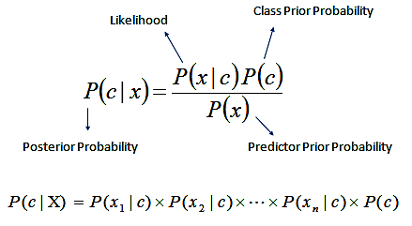
Naïve Bayes
Naive Bayes is the easiest and fastest classification algorithm for a large chunk of data. It is mainly used for unknown classification prediction. The use of Bayes’ theorem with a robust independence assumption between the facets is the foundation for naive Bayes classification. When used for textual information analysis, such as Natural Language Processing, the Naive Bayes classification yields true results.
Bayes theorem offers a way of calculating posterior probability P(c|x) from P(c), P(x) and P(x|c).

Slide 27
Support Vector Machine
A universal learner is the Support Vector Machine. Both the input and output formats for the Support Vector Machine have been established. The input is vector space, and the output is either positive or negative.
The text is converted into a format that the machine learning system can understand. The texts' scores are computed, and the results are then fed into the Support Vector Machine. The Support Vector Machine has been proven to be one of the most powerful text categorization learning systems

Slide 28
Decision Tree
The most powerful and widely used tool for categorization and prediction is the decision tree. A decision tree is a flowchart-like tree structure in which each internal node represents an attribute test, each branch reflects the test's conclusion, and each leaf node (terminal node) stores a class label. As decision trees are supervised algorithms, they must be trained using annotated data

Slide 29
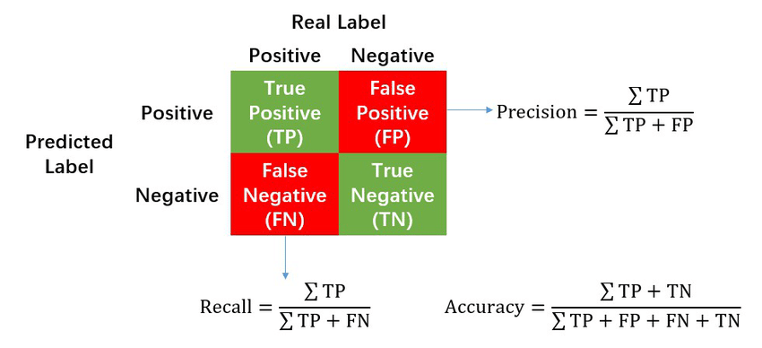
Evaluation Methods

Slide 30
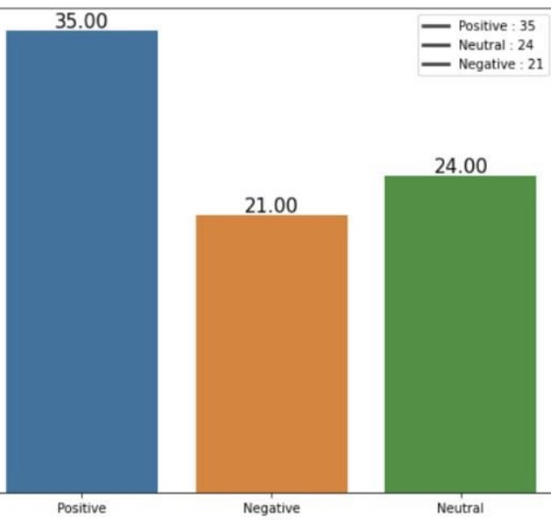
For BJP
Results using Lexicon based approach

Slide 31
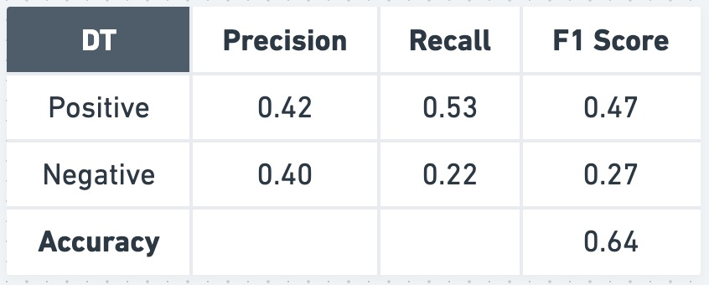
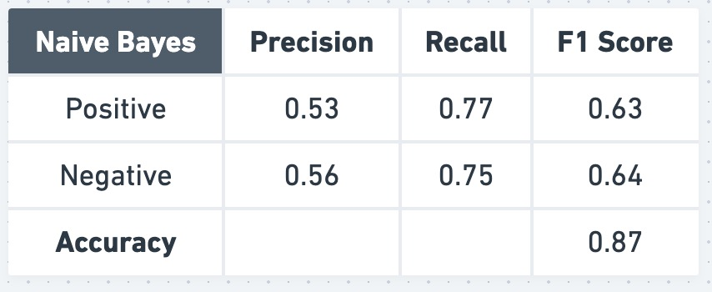
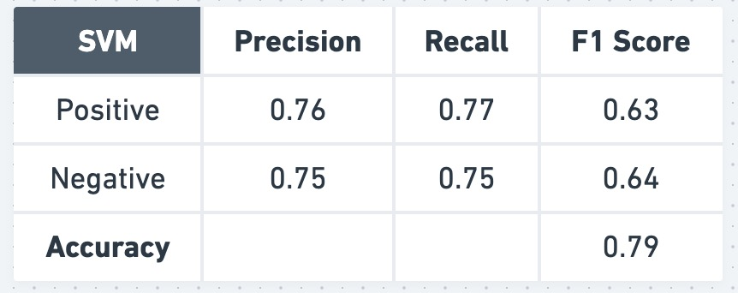
Results using ML models of BJP

Slide 32
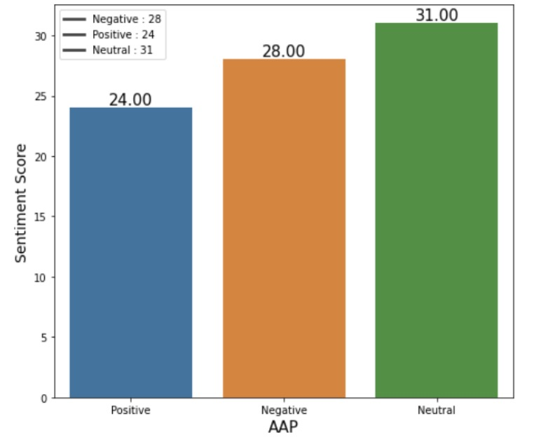
For AAP
Results using Lexicon based approach

Slide 33
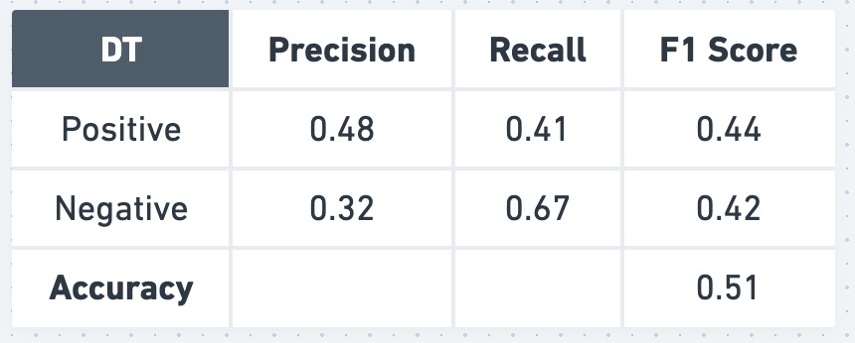
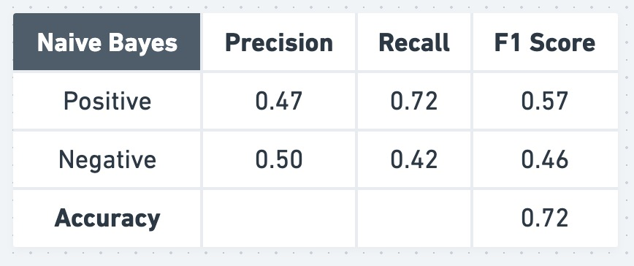

Results using ML models for AAP

Slide 34
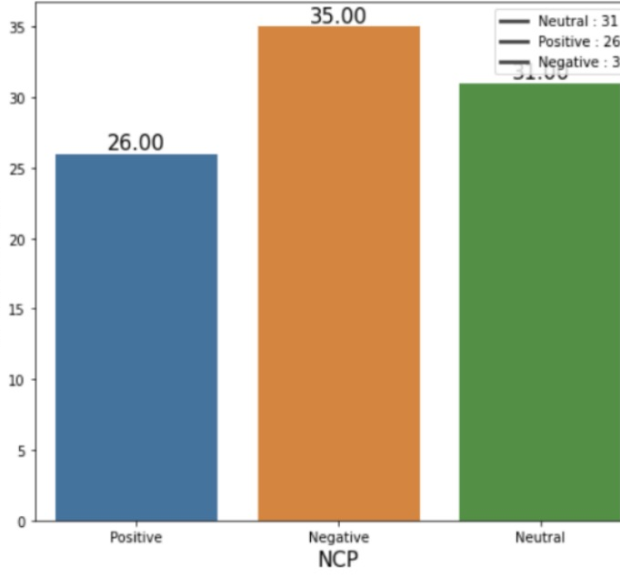
For NCP
Results using Lexicon based approach

Slide 35
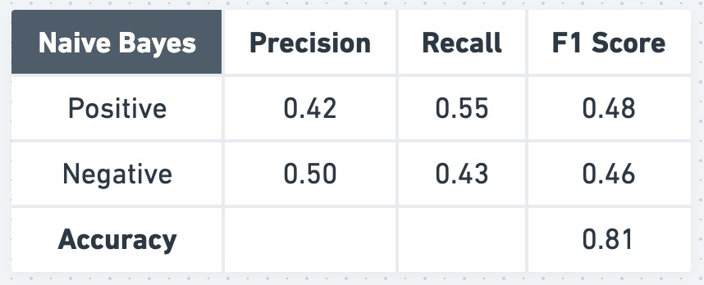
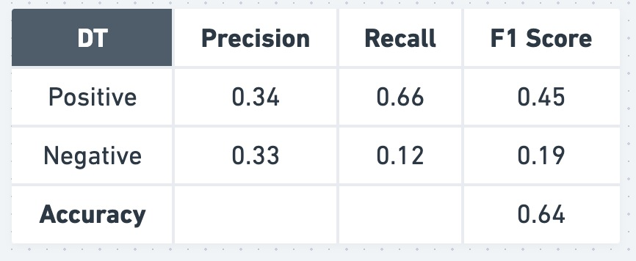
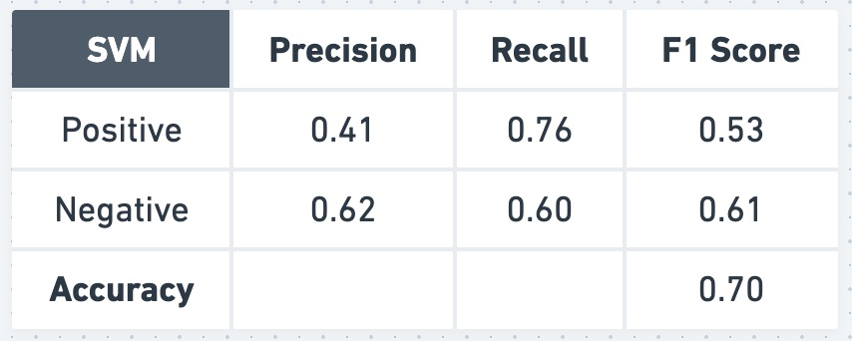
Results using ML models for NCP

Slide 36
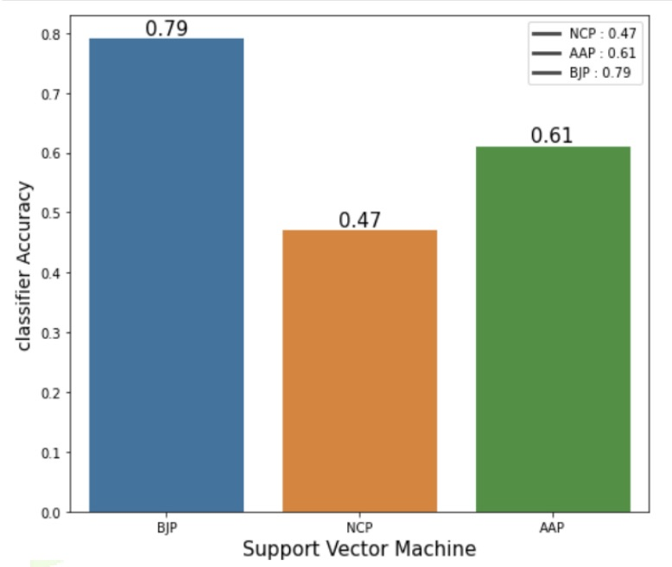
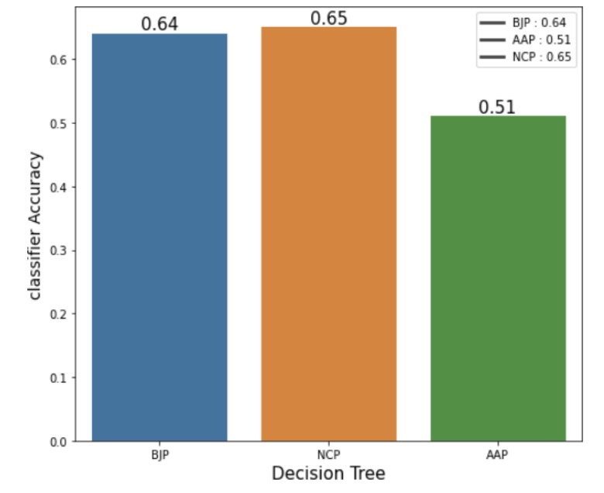
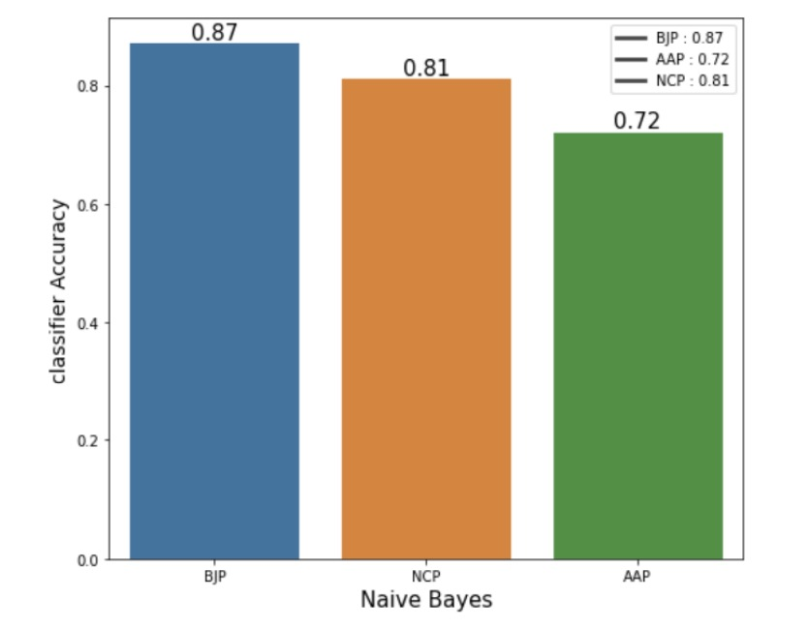
Comparing Accuracy of ML Models

Slide 37
Results
On the basis of the results of our experiment we got the highest accuracy for the Naïve Bayes classifier,
Using Naïve Bayes Classifier for the tweets for BJP accuracy is 87%, for NCP accuracy is 81%,for AAP accuracy is 72%.
Using Support Vector Machine Classifier for the tweets for BJP accuracy is 79%, for NCP accuracy is 47%,for AAP accuracy is 61%.
Using Decision Tree Classifier for the tweets for BJP accuracy is 64%, for NCP accuracy is 65%, for AAP accuracy is 51%

Slide 38
Also we got highest positive sentiment for BJP is 35% , for NCP is 26% , and for AAP is 24%. So, according to this experiment Naïve Bayes Classifier is better classifier to get accurate results.
According to our experiment, we got a total number of positive tweets for BJP to be 36%, congress to be 27%, and AAP to be 25%. As we are calculating the winning in the Lok Sabha election and the major parties contesting are BJP and congress we can clearly see that BJP is winning.

Slide 39
In our project, we have mainly focused on 2 approaches The first approach involved is the highest positive sentiment score for the party participating in the loksabha election 2019. The second approach is using a data mining algorithm we calculate sentiment score and accuracy from our tweet dataset of three parties and also show comparative about classifiers for which classifier is the better classifier.
Also, among the three classifiers i.e Naïve Bayes classifier, SVM classifier, and Decision Tree classifier, the Naïve Bayes classifier proves to generate a better result than the others.

Slide 40
Conclusion
Political parties can adopt the suggested system to enhance their election-season campaigning tactics. They might utilize it as a component of social media analytics to research the trends of other political parties. The user can cast an informed ballot by looking at the political parties' current tendencies. This methodology can be applied as a long-term strategy for a political party to research public sentiment over an extended period of time by political analysts and strategists. This project focused on investigating social platform (Twitter) as the chase for elections' campaign after observing the increased use of social media platforms.

Slide 41
THANK YOU
PRESENTATION BY -
PARNEET SINGH 2020UCO1670
AKHIL DUBEY 2020UCO1673
AMAN KUMAR JHA 2020UCO1674

